Slide 1
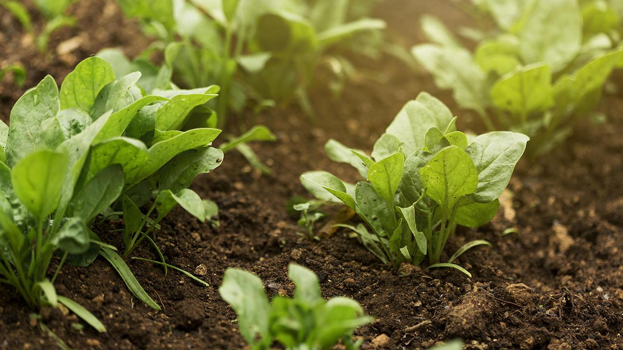
Smart Agriculture Crop Yield Predictor
IIC#13 by Celebal Technologies Team Name-Vital Coders

Slide 2
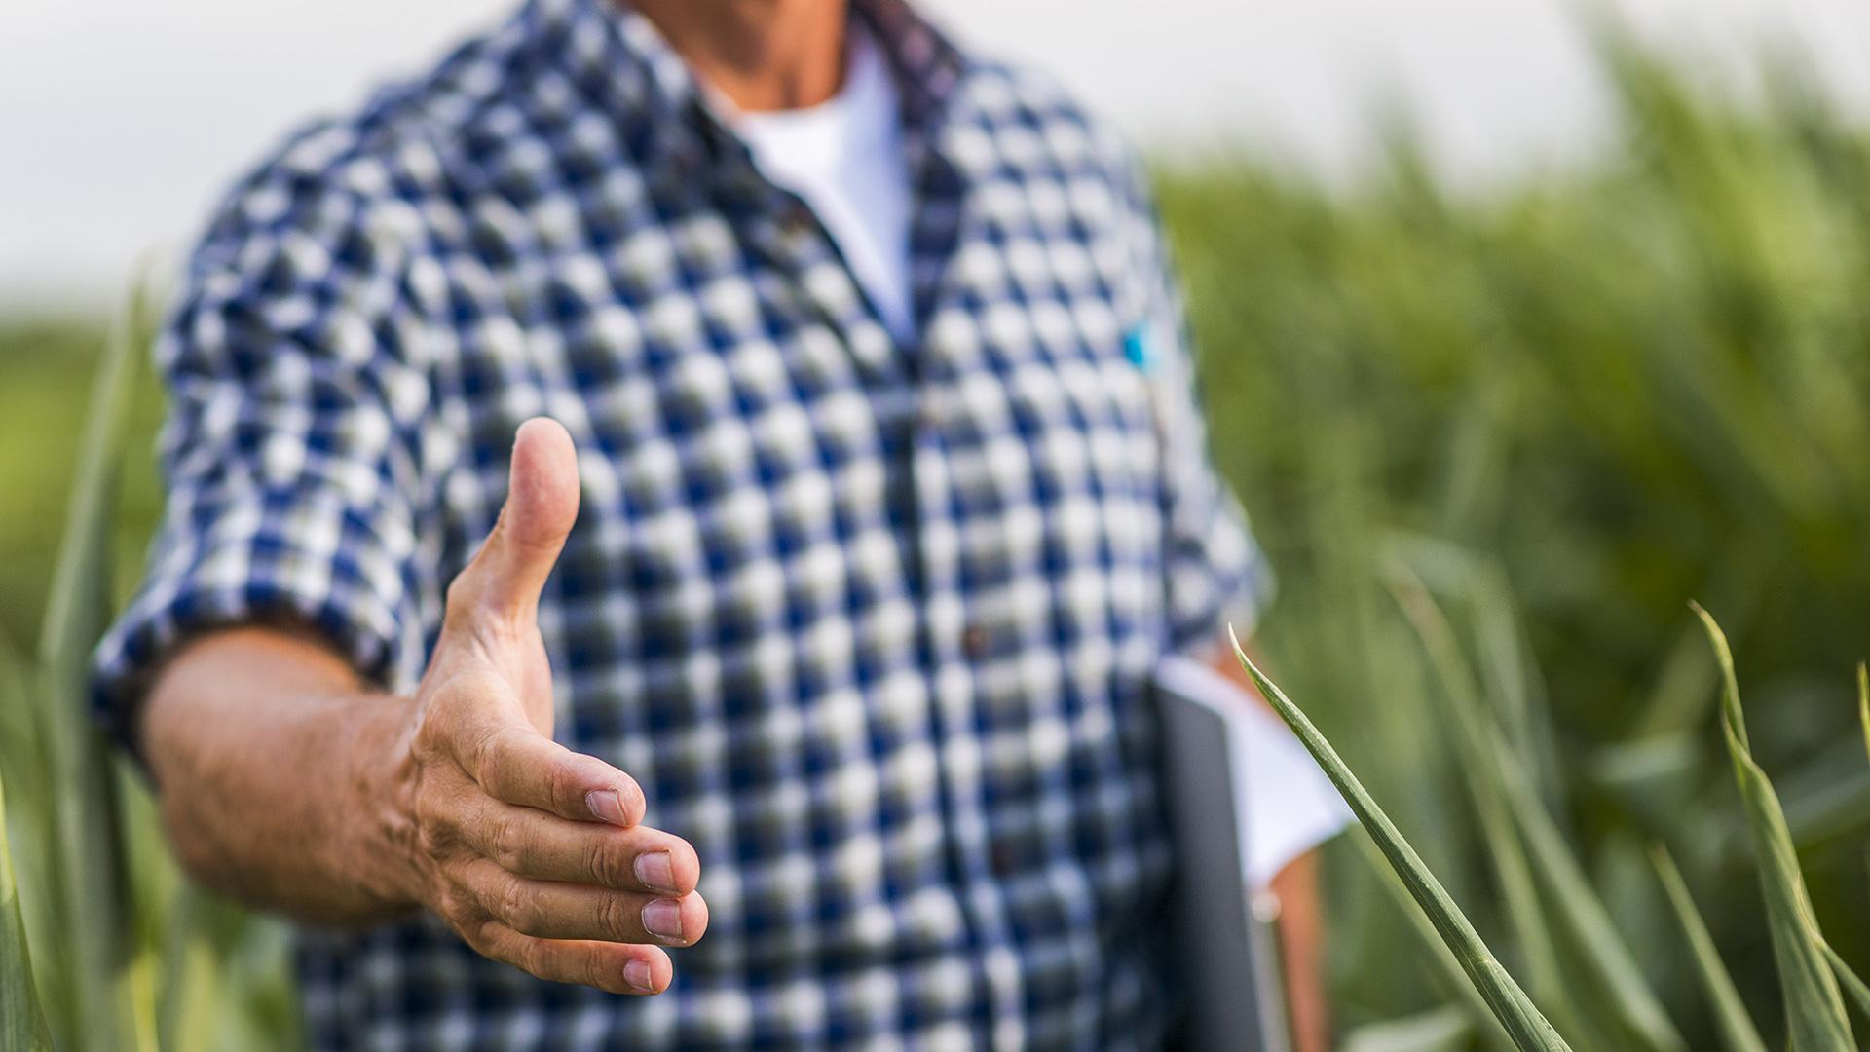
01
The Problem

Slide 3
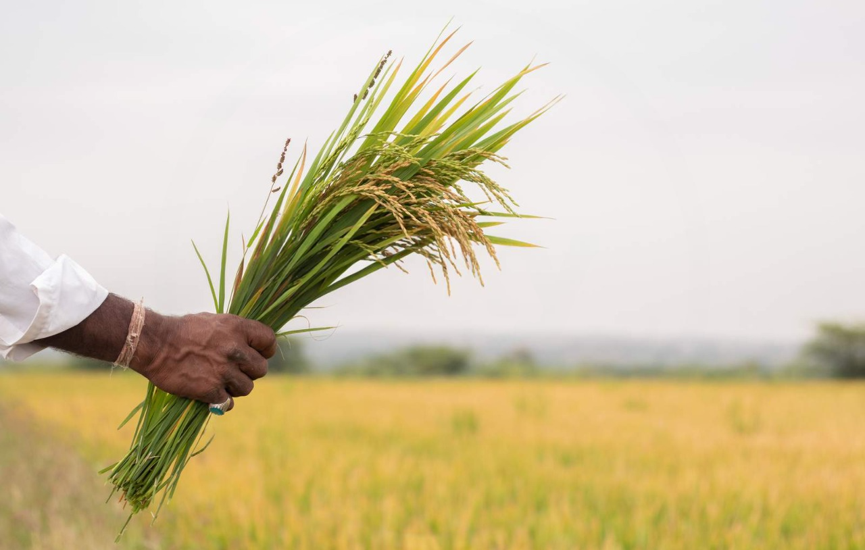
The Problem
Challenges faced by farmers:
Uncertainty in crop yield.
Lack of actionable insights for improvement.
Difficulty in integrating technology for decision-making.
These issues lead to lower productivity, economic losses, and environmental impact.

Slide 4
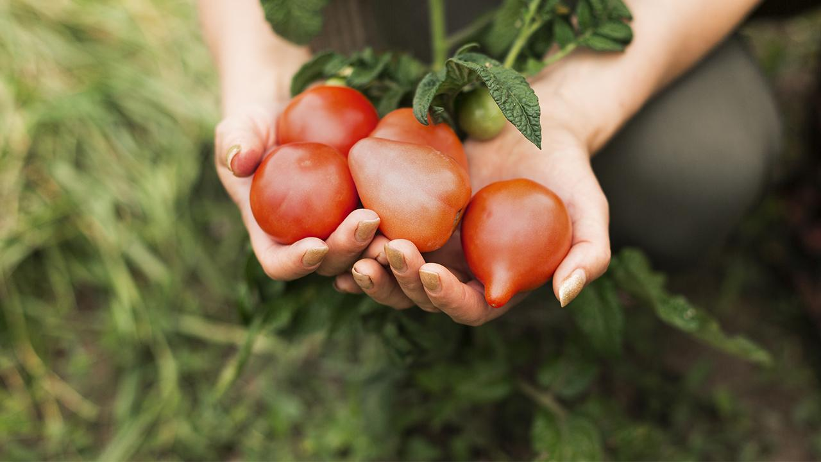
02. Our Solution

Slide 5
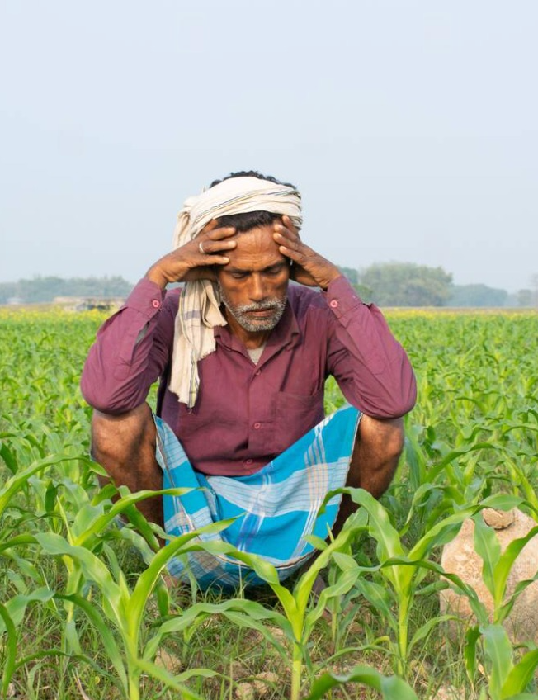
Our Solution
To build a user-friendly platform that uses data and machine learning to predict crop yield and provide personalized recommendations.

Slide 6
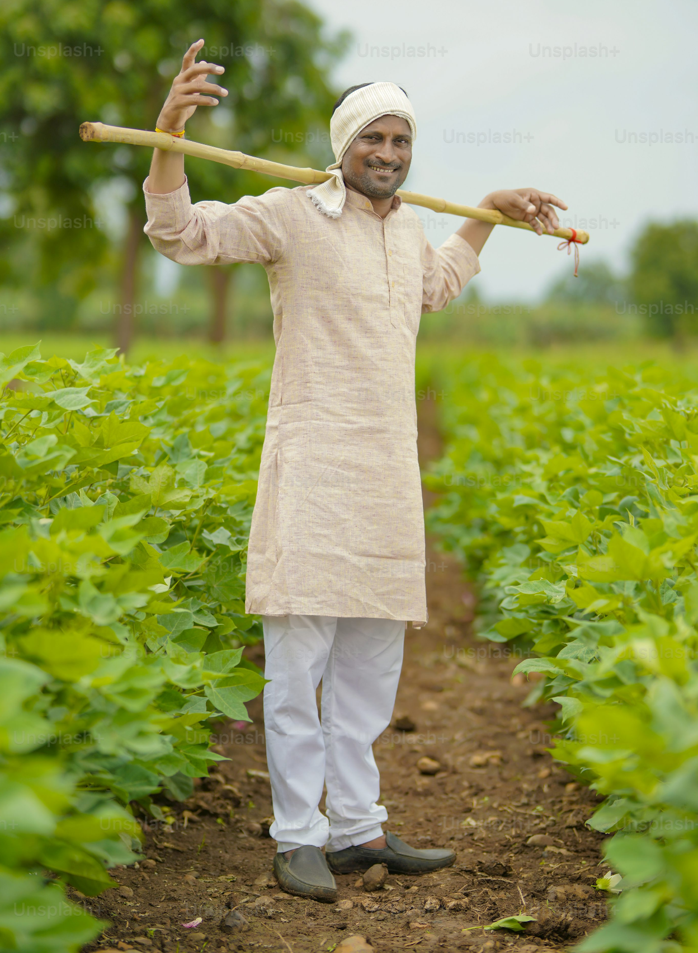
Problem vs. solution
What We’re Building
A platform where farmers can input crop details manually and via IoT sensors.
Machine learning predicts crop yield based on soil, weather, and crop data.
Farmers receive actionable insights to improve productivity.
Solution
Makes farming smarter and more data-driven.
Reduces uncertainties, saves resources, and boosts yield.

Slide 7
Features of Our Solution
User-Friendly Form
IoT Integration
Farmers can easily input crop and field details.
Sensors automatically collect real-time soil and weather data.
Practical Tips
Mobile and Web Friendly
Guidance on irrigation, fertilizers, and pest control.
Accessible on any device
Accurate Predictions
Multi-Lingual Interface
ML models analyze the data to predict yield.
Accessibility for farmers across regions.

Slide 8
Tech Stack
Machine Learning
Frontend
Backend
IoT Sensors
Database
HTML, CSS, JavaScript, or Flutter
Flask or Django for processing inputs and running the ML model.
Despite being red, Mars is a cold place
Soil moisture, pH, temperature, and humidity sensors
Firebase or SQLite to store user and sensor data

Slide 9
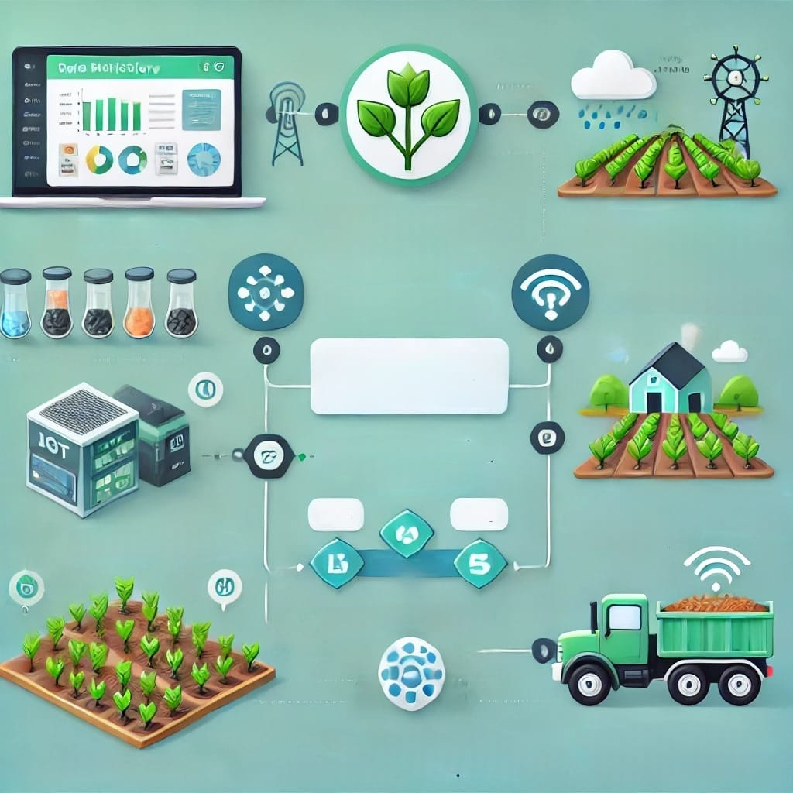
Workflow
Dataset
Manual input of data using web or app
Data Collection Using Sensors
Data Integration
Machine Learning Crop yield predictor
Yield Prediction
IOT Integration
Output

Slide 10
Why This Matters
Improved Productivity
Data-Driven Farming
Affordability
Sustainability
Empowers farmers with actionable insights.
Boosts crop yield and minimizes losses
A cost-effective solution accessible to small-scale farmers
Encourages environmentally friendly farming practices

Slide 11
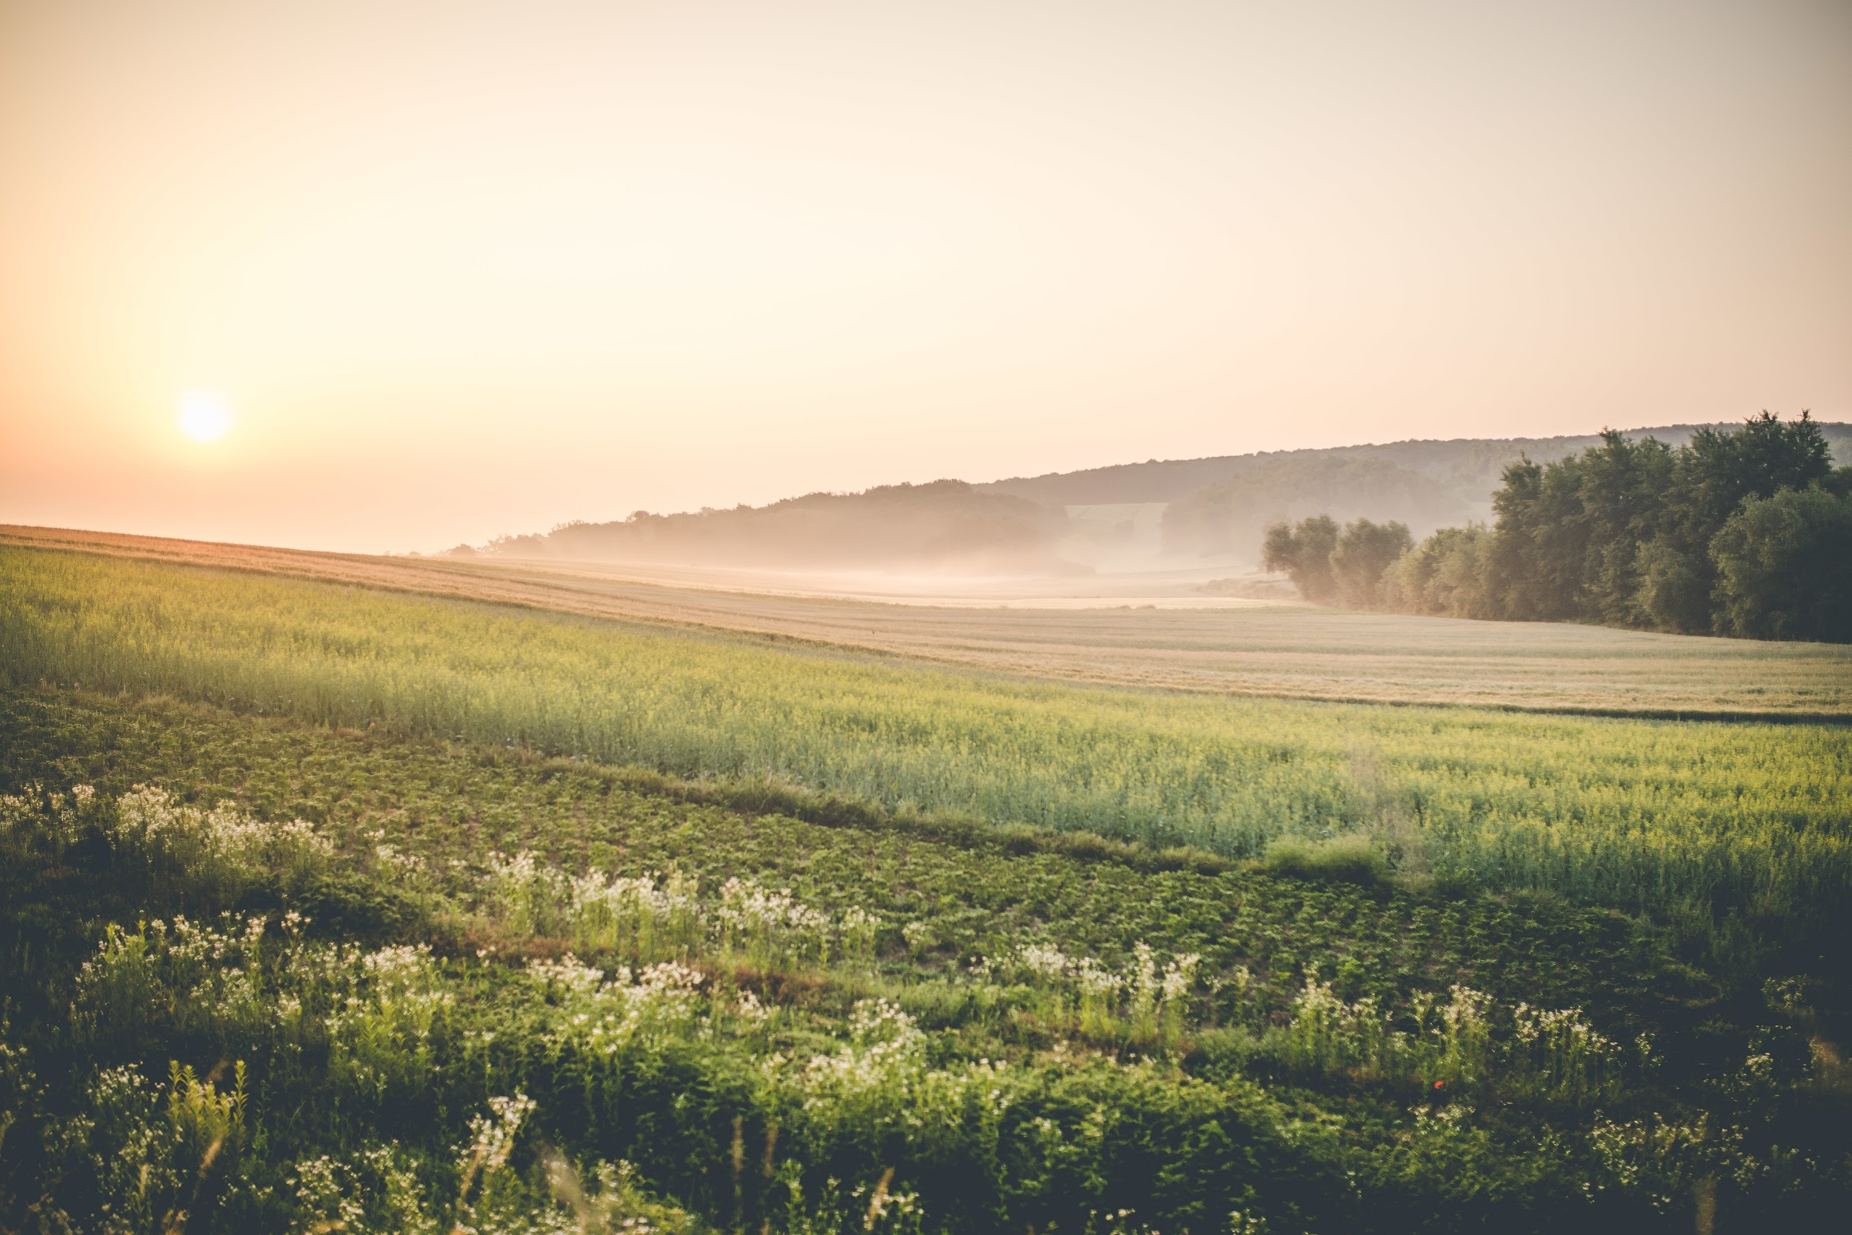
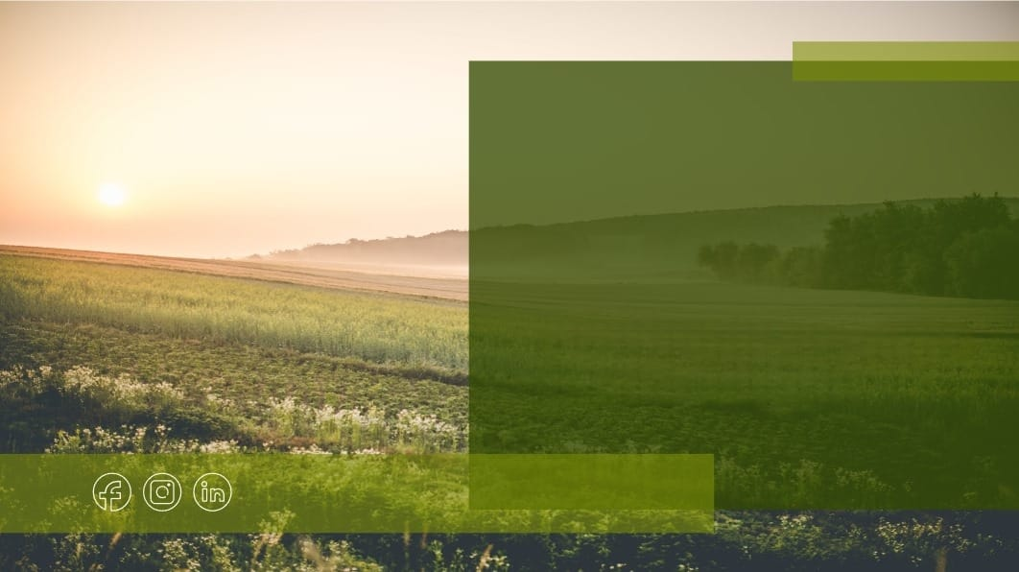
Thanks!

